Slide 1
College Group #1
Summative Assessment

Slide 2
邀请信
恭喜你！你会代表XXX大学参加美国XX部地区大学生“汉语桥”演讲比赛。
XXXX年比赛的主题是：年轻人认为网络是痛还是爱？
请准备一篇3-5分钟的演讲稿。
←Scenario
Instructions:
Read a short Zhihu article and complete reading tasks - Handout #A (Interpretive reading)
Mock presentation and peer feedback - Handout #B & #C (Interpersonal communication)
Finish your speech - Handout #D (Presentational writing)
Notes:
Chinese Bridge: https://en.wikipedia.org/wiki/Chinese_Bridge

Slide 3
Task #1 – Use Day5 handoutA
怎么准备呢？一位中国朋友建议说，可以看看“知乎”这个网站上中国年轻人对这个话题的看法，一定对准备演讲稿有帮助。
知乎短文 Day5 handoutA
*Background knowledge: [Wikipedia] Zhihu (Chinese: 知乎; pinyin: Zhīhū) is a forum website where questions are created, answered, edited, and organized by its users.
Their main users are college-aged young people and young professionals.
Notes:
知乎文章原文：https://zhuanlan.zhihu.com/p/355085489
改写后的版本：https://bit.ly/44Xtwey

Slide 4
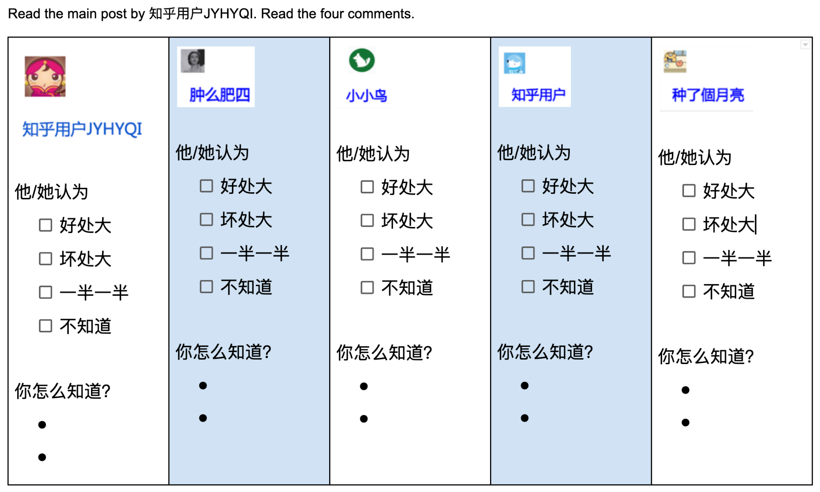

Slide 5
没说坏处
说了1好2坏
没说坏处
没说坏处
最后一段

Slide 6
Task #2 – Use Day5 handoutB
看了别人写的短文，那现在可以想想应该怎么写自己的演讲稿。
Use the chart in handout #B to organize your own ideas and draft your speech. Start with paragraph #1 in class. Complete your draft after class. Bring your draft to next class for peer feedback.

Slide 7
Task #3 – Use Day5 handoutC
Mock Presentation & Peer Feedback
Instruction:
3-4 people form a small group
One student presents his/her speech, the other students use the checklist to provide feedback.
Change roles. The 2nd student presents, the other students give feedback.
Then, the 3rd presents (and then, the 4th).

Slide 8
Final Summative Task – Day5 Rubrics
听了同学们的建议，请写好你的演讲稿吧。
XX月XX日交给老师。

